Slide 1
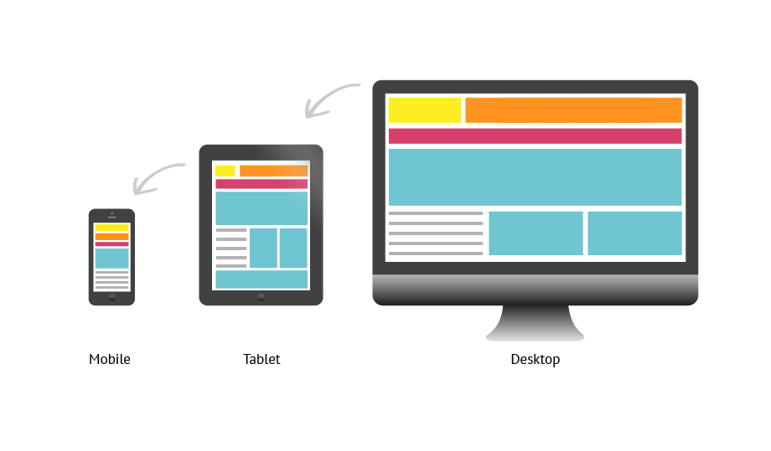
WEB RESPONSIVE DESIGN
Mh jafory
contactme@mhjafory.com | www.mhjafory.com

Slide 2

RESPONSIVE WEBSITE BASICS
IN 3 SIMPLE STEPTS
META TAG
HTML STRUCTURE
MEDIA QUERIES
Mh jafory

Slide 3

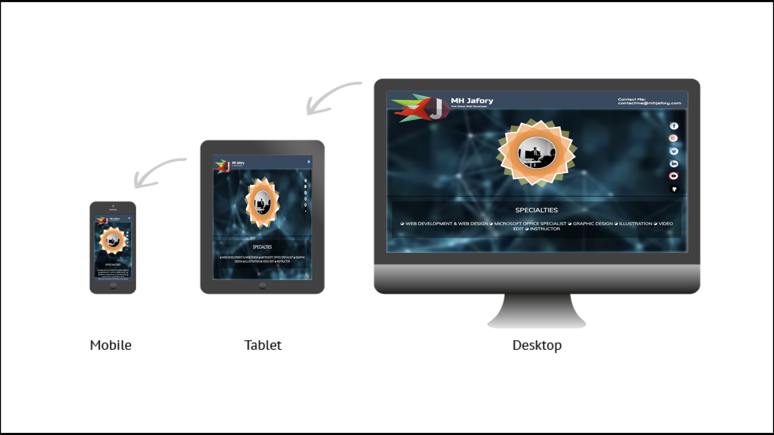

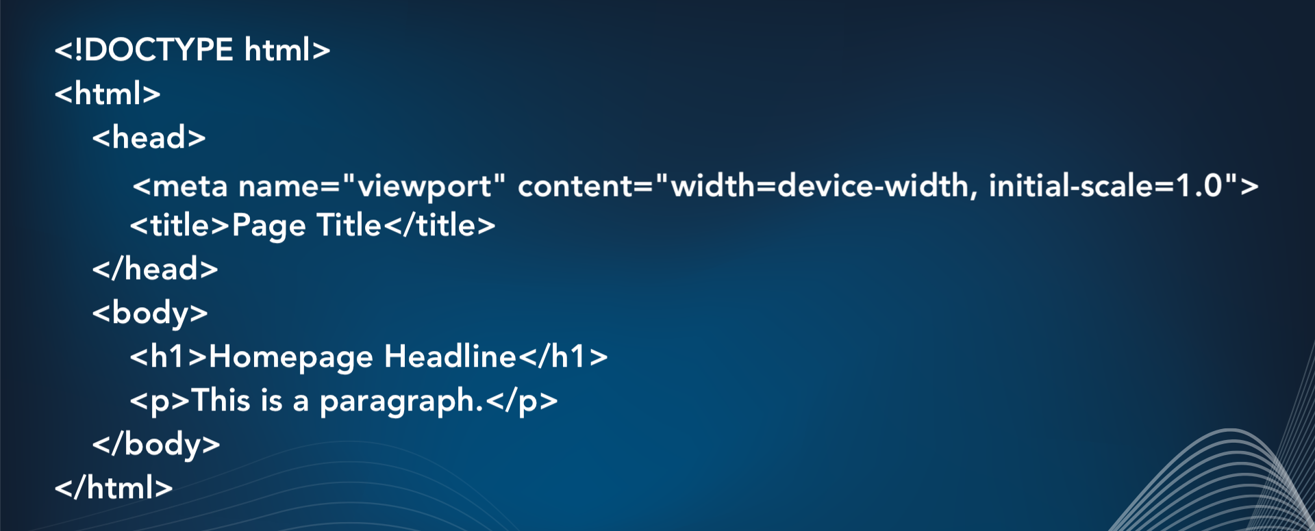
HOW DOES EACH LOOK LIKES?
Mh jafory

Slide 4
We will watch quick DEMO video
Mh jafory

Slide 5
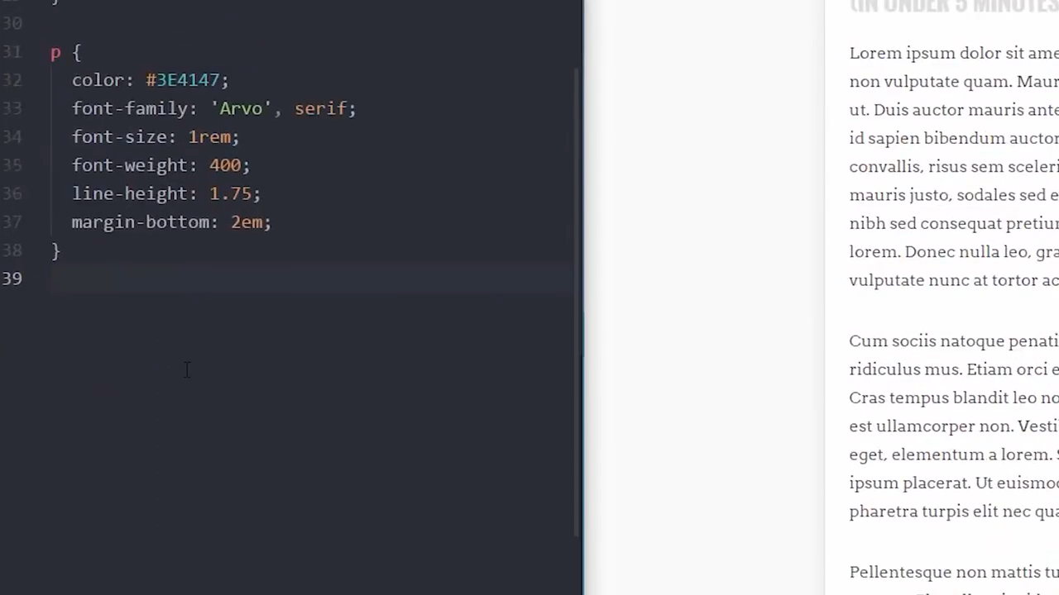
We will watch quick Demo video
Mh jafory

Slide 6
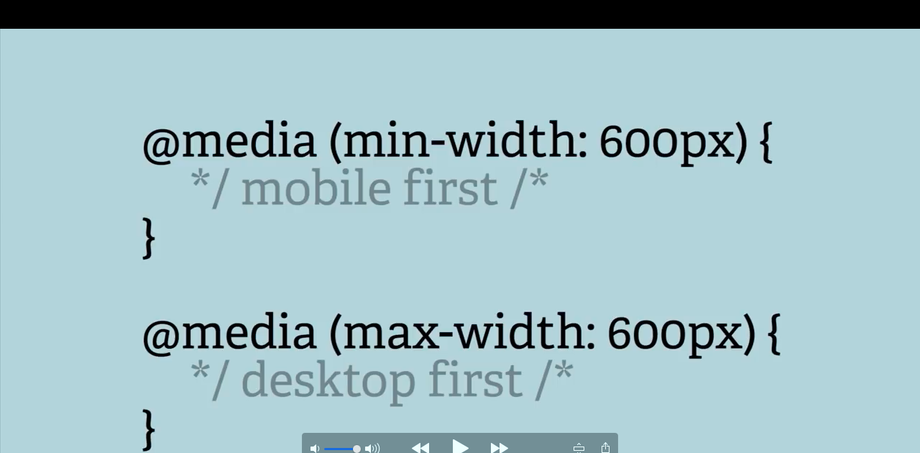
Mh jafory

Slide 7
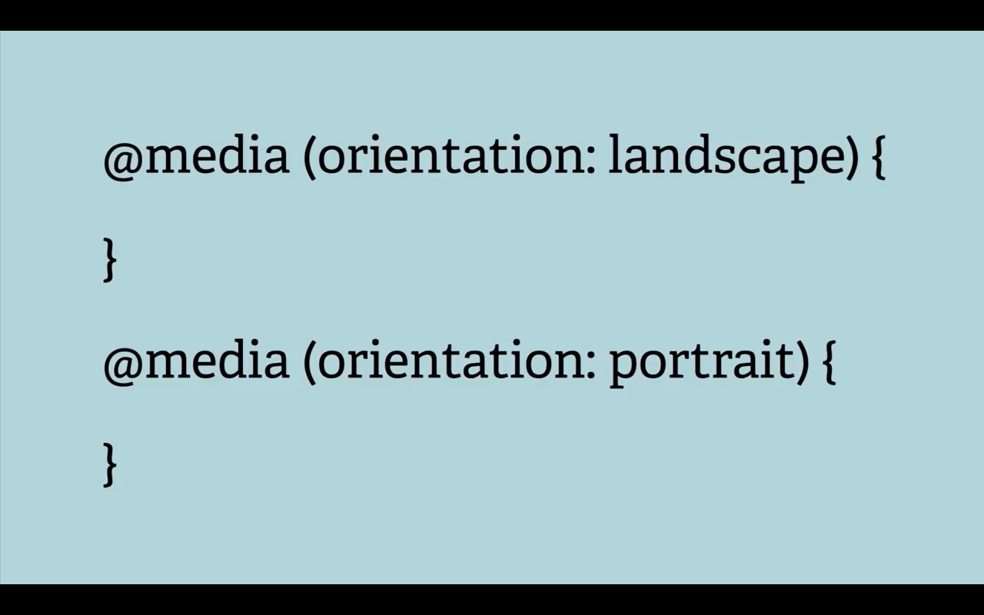
Mh jafory

Slide 8
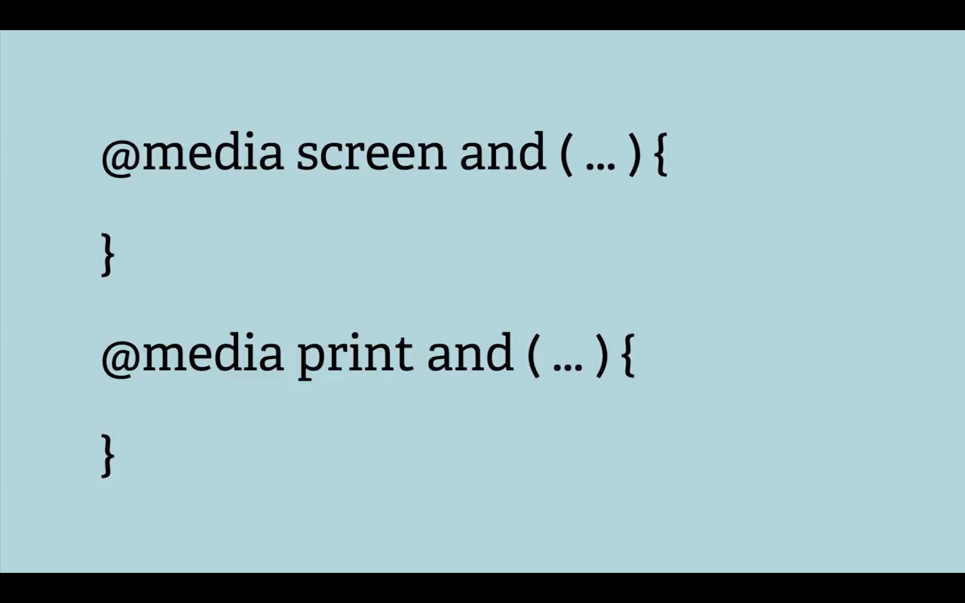
Mh jafory

Slide 9
Reference below the SITE
GITHUB
YOUTUBE
GOOGLE
Mh jafory

Slide 10
Mh jafory

Slide 11
Thank you everyone
Mh jafory

